Slide 1


Wiping out statistics anxiety and code fear – getting quantitative!
Gergana Daskalova
16th Nov 2016, University of Edinburgh

Slide 2

Workshop outline
Coding Club – our team & values
Quick survey
Intros & discussion
Tutorial
An even quicker survey

Slide 3
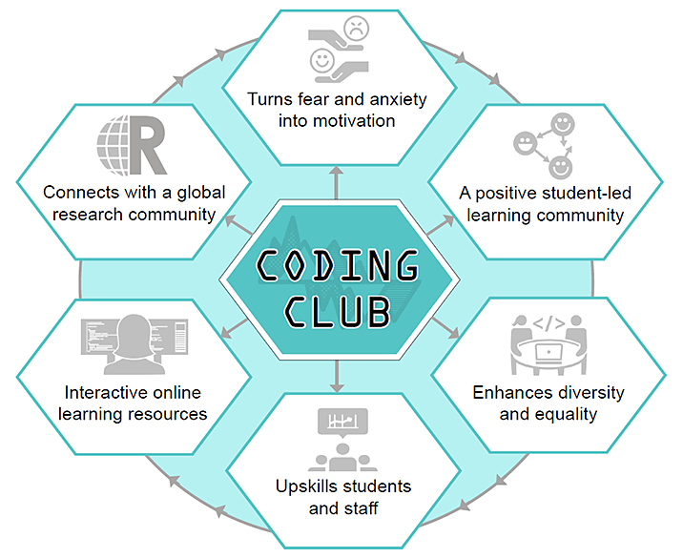
Our team & values

Slide 4
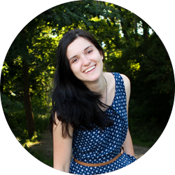



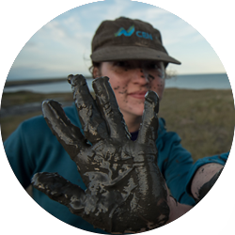
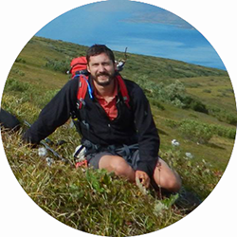


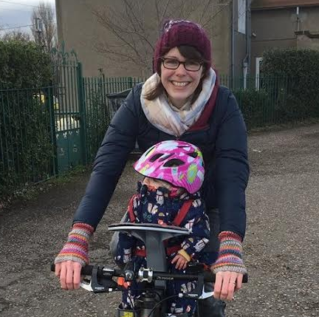
Our team & values
Gergana
John
Eleanor
Joe
Sandra
Haydn
Pedro
Kyle
Isla
Chrissy

Slide 5
Our team & values

Slide 6
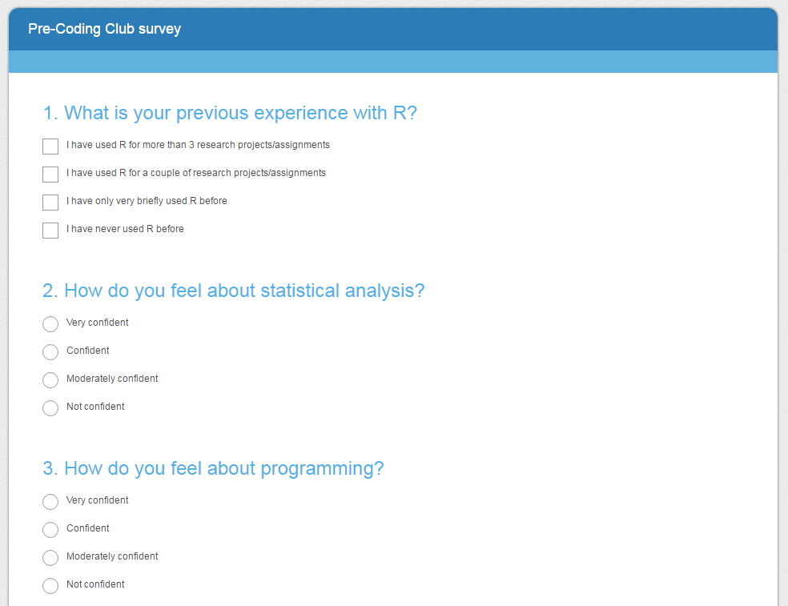
Quick survey
https://www.surveymonkey.co.uk/r/6DF5BVZ

Slide 7
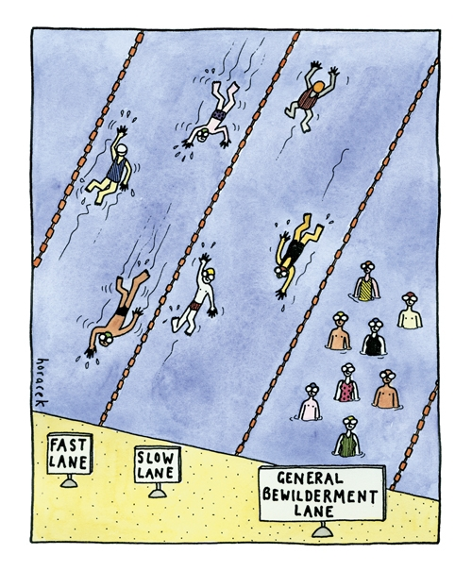
Discussion
What’s your favourite thing about stats and programming?
What’s your proudest R moment?
Any funny R moments?

Slide 8
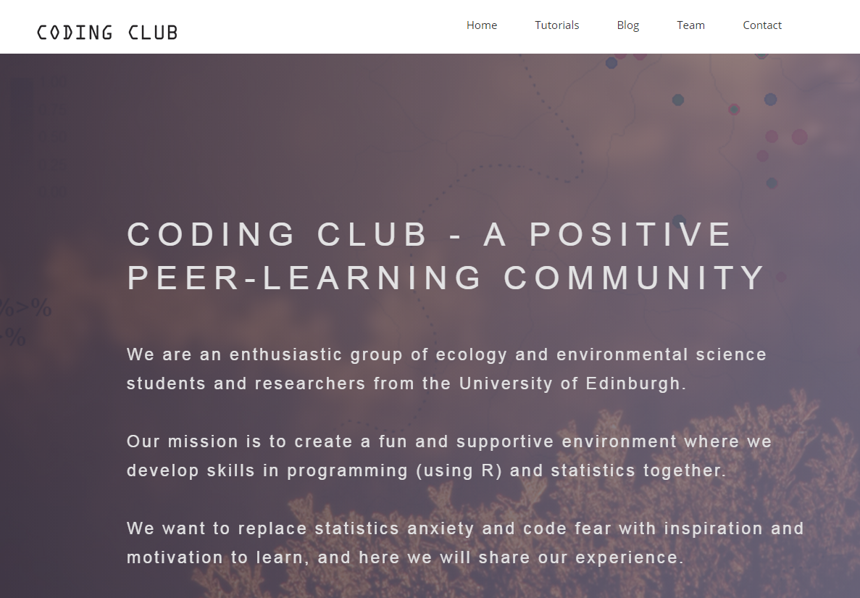
Tutorial – intro to R
https://ourcodingclub.github.io/

Slide 9
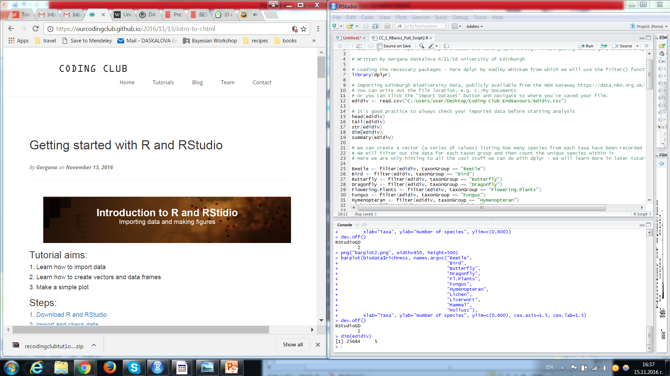
Tutorial – intro to R
https://ourcodingclub.github.io/

Slide 10
We would love your feedback!
https://www.surveymonkey.co.uk/r/6CQF3J7
Thank you for helping us make Coding Club better!

Slide 11

Next steps
EES students can go through Chrissy’s and Kyle’s VLE (Virtual Learning Environment) on Learn
Code Academy’s tryR course - http://tryr.codeschool.com
For fun, check out https://twitter.com/accidental__art
Come back for our next workshop, Wednesday 2-4pm, Crew 301!
By Matthew Perry

